Slide 1
Microsoft Azure

Slide 2
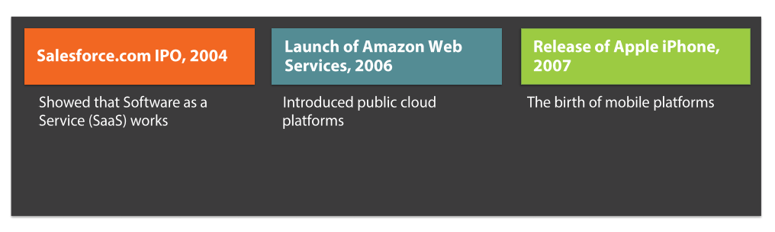
Why do we need Azure at all?
Notes:
Tempting to jump in and start writing code and deploying services, but hold on…

Slide 3
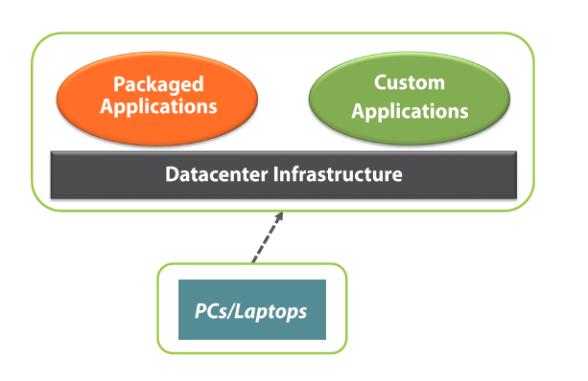
Enterprise IT – Traditional World
Notes:
Tempting to jump in and start writing code and deploying services, but hold on…

Slide 4
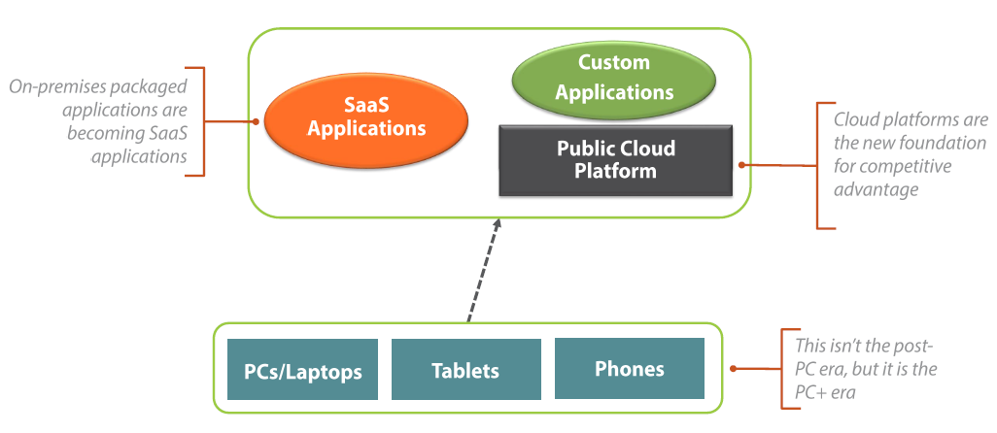
Enterprise IT – Cloud World
Notes:
Tempting to jump in and start writing code and deploying services, but hold on…

Slide 5
Pre-Requisite

Slide 6
Pre-requisite knowledge
Client – Server architecture
Mode client => more load => more resources to handle
Architecture qualities
Availability
Reliability
Maintainability
…many more
Scale up – scale out
Notes:
Provide definitions of architecture qualities

Slide 7
Pre-requisite knowledge
Scale up
Scale out
Scale out your web tier using stateless web servers behind smart load balancers
Load balancer
Round robin
Sticky session
Redundancy
Failover
Clustering
Geo-redundancy
Virtualization
Notes:
Provide definitions of architecture qualities

Slide 8
How does it matter to Azure?
Companies invested fortune in hardware and software infrastructure, processes and people
Near instant provisioning to meet load, without any human involvement
Scale back automatically – auto scale configuration
Load balancing, redundancy baked in
Hybrid approach
Something for everyone – small and large organizations (Bizspark)
Start for free!
Notes:
Provide definitions of architecture qualities

Slide 9
What is Azure?
A cloud computing platform which allows you to perform virtually any compute or data storage operation by provisioning and scaling necessary resources on demand and pay-as-you-go basis.
Notes:
1. On demand and pay-as-you-go basis are important selling points for business customers.

Slide 10
Cloud computing enables you to
Reach more customers / users in a richer way
Deliver solutions not possible / practical before
Be more cost effective by paying only for what you use
Leverage a flexible, rich development platform
Notes:
1. On demand and pay-as-you-go basis are important selling points for business customers.

Slide 11
Azure Ecosystem
Massive Scope
Notes:
Each service is there for a specific purpose / business problem
Choose right service for the job

Slide 12
Azure Ecosystem – List
Website
Website Gallery – Wordpress, Drupal etc.
WebRole
Virtual Machines
Azure SQL
Cache
Mobile Services
Azure CDN

Slide 13
Azure Ecosystem – List
Backup
Traffic Manager
Portal, Monitoring Alerts, Auto scale
Insights, website diagnostics
Active directory
Multi-factor authentication
Social logins using Facebook, Twitter, Google etc.
Azure Search
Media Services

Slide 14
Azure Ecosystem – List
Azure Storage Queue
Service Bus
Azure Scheduler
Machine Learning
API Management
Cross platform notification hub
Backup and recovery
Staged publishing using deployment slots
Virtual Network

Slide 15
Azure Ecosystem – List
Visual Studio Online
Load testing features in with Visual Studio online
Publish from source control like GIT, TFS etc.
Azure BizTalk for broker between different applications

Slide 16
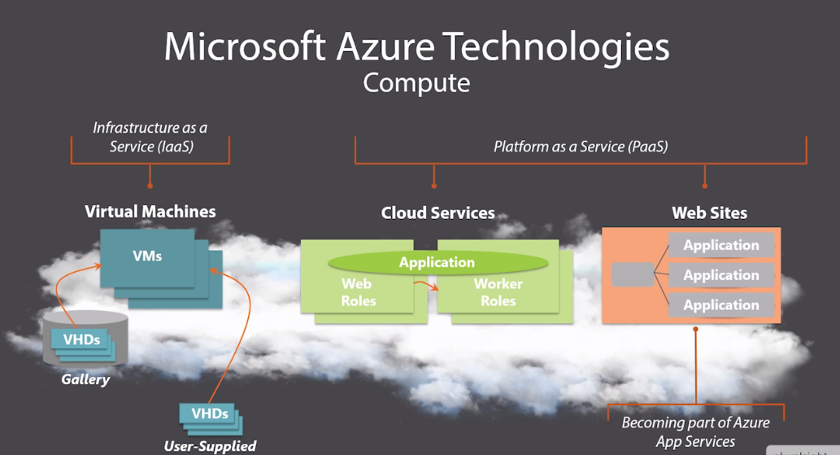
PaaS – IaaS - Saas

Slide 17
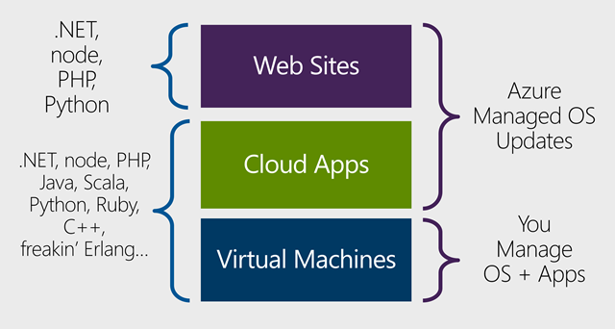
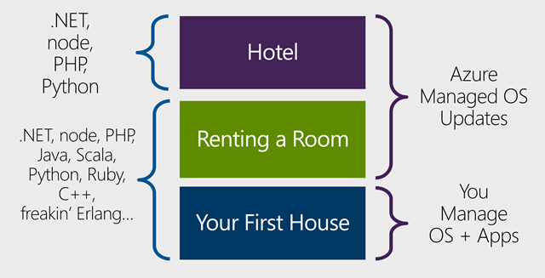
PaaS – IaaS - Saas
Scott Hanselman’s analogy on responsibility vs control
Source: http://bit.do/webjobs

Slide 18
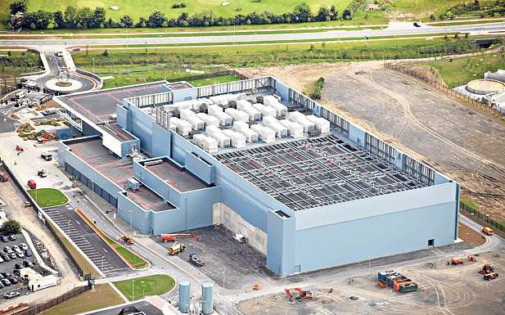
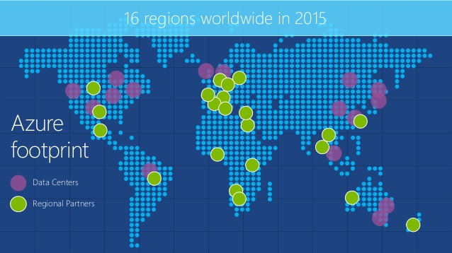
Azure Geo, Region and Data Centers

Slide 19
How does it matter to my application?
Deploy your services to the regions where your customers are for better performance
Deploy services in single region to avoid network latency
Spreading services across different regions results into outgoing data cost between those services
Microsoft might transfer your data across different data centers or geo for disaster recovery scenario
Not all regions supports all Azure services

Slide 20
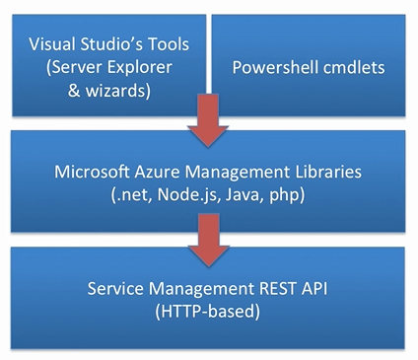
Common ways to work with Azure
Azure portal
Preview portal
Powershell cmdlets for administrators
Visual Studio server explorer
SQL Server management studio
Webmatrix, FTP, Source control deploy etc.
Scripts! (ScottGu talk http://bit.do/scottgu)

Slide 21
Demo
Azure portal
Preview portal
Powershell cmdlets for administrators
Visual Studio server explorer
SQL Server management studio
Filezilla

Slide 22
Understanding Accounts
Azure Account
Global azure account to start playing with Azure
Microsoft Account
Your personal account
Organizational Account
Identify user within enterprise / organization
@onmicrosoft.com

Slide 23

Azure – Active Directory

Slide 24
What is it?
Free Active Directory service in cloud
Keeps track of organization’s users and resources within organization
Authenticate and authorize users to access resources
Can be used to authenticate and authorize resources outside organization
Premium service can be used to integrate on-premise active directory with the cloud version
Each subscription trusts only one Active directory, however one active directory can be trusted by many subscriptions.

Slide 25
User Management
Create new user demo
User with Microsoft account for external user collaboration
User from another Active directory

Slide 26
Role Management
Subscription Administrator
Directory Administrator
http://bit.do/role-permissions

Slide 27
Azure - Website

Slide 28
Website - Introduction
Microsoft recommended solution for web applications – legacy as well as new apps
Runs on IIS8 with Windows Server 2012
PAAS
Web Sites vs. VM
Web Sites VS Cloud Apps VS Virtual Machine { Hotel analogy}

Slide 29
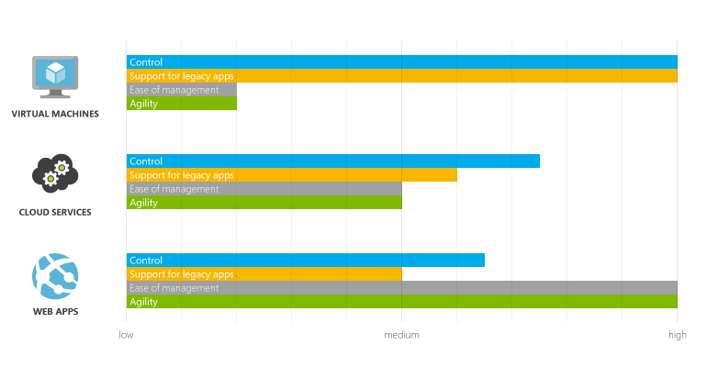
VM – Cloud Service - Website

Slide 30
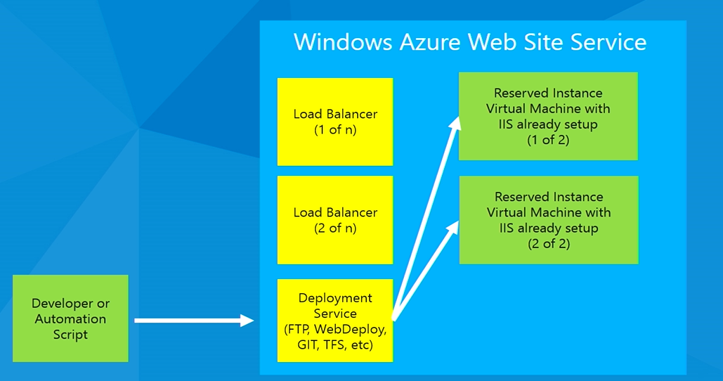
Azure Website Service - Deployment

Slide 31
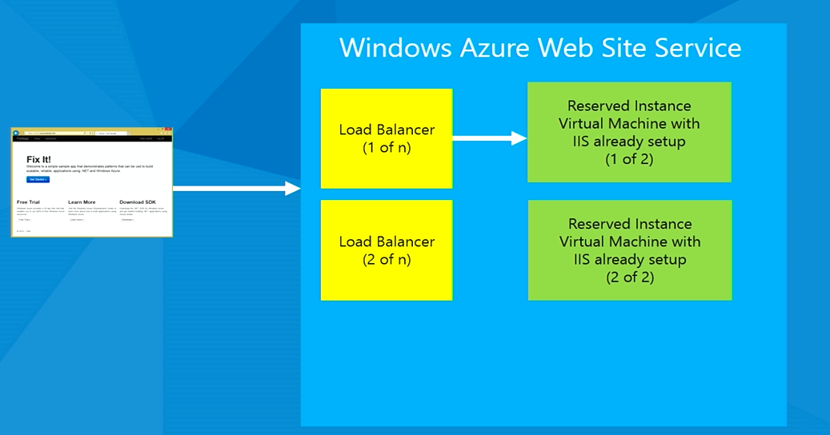
Azure Website Service – Load Balancer

Slide 32
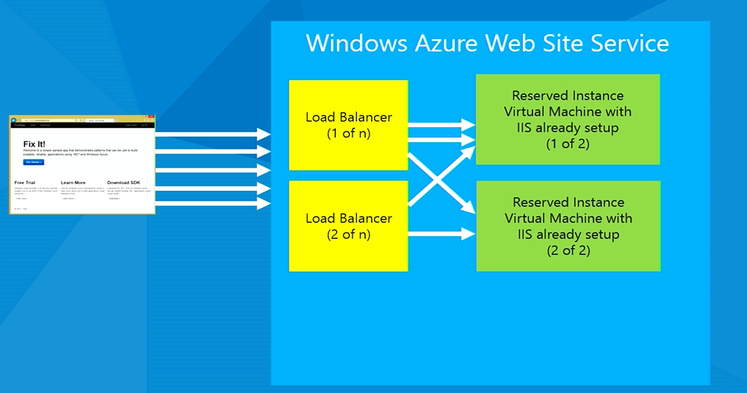
Azure Website Service – Load Balancer

Slide 33
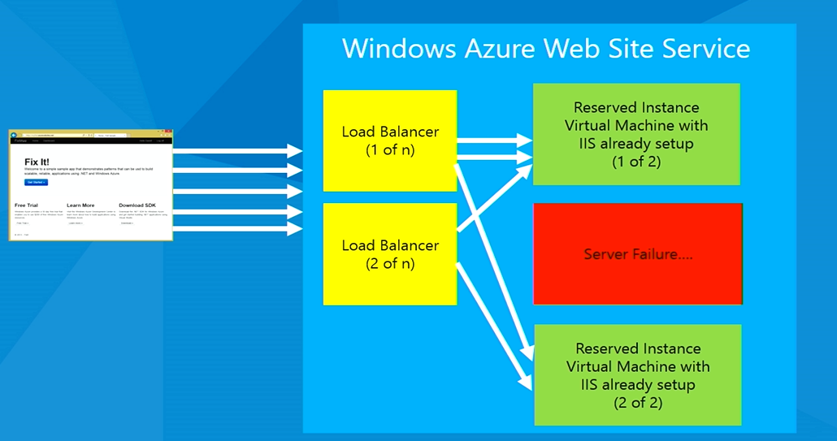
Azure Website Service – Server Failure

Slide 34
Deployment
4 Main Types
FTP
Web Deployment using VS
Kudu
Deployment from master branch
Change branch and sync
TFS
Publishing Profile

Slide 35
Debugging
Web
FTP

Slide 36
Scale
Tiers – Free, Shared, Basic, Standard
Instance Count
Billing = (number of instances * number of core) in hours
Dedicated VM
Manual vs. Auto
Resource Group in new Azure portal for logical grouping

Slide 37
Configuration
DNS lookup
Region
Appear / Disappear depending on capacity
Endpoint monitoring
App Setting , connection string manipulation using PowerShell

Slide 38
Configuration continue
Logging
Application logging
Web logging
Kudu logging
Live stream logging
Web Site Log Viewer Extension by Amit Apple
Monitor using cmdlets
Azure site log <<websitename>>

Slide 39
Monitoring / Health
Add Metrics
Setup Rule Alert

Slide 40
Deployment Slots
Switch between production and staging with ease
Delete deployment slot
Notes:
http://bit.do/staged

Slide 41
Web Jobs
Continuously running jobs along with a website
Bad practice is to create a background thread and let it do the work. This can impact website performance.
Two modes
Triggered Tasks
Continuous Service
Deployment
Using Zip file [Package everything under bin/debug]
Using Visual Studio
Copy to MVC App path App_Data\jobs\triggered and deploy MVC App

Slide 42
Multiple Technologies Support
Bring your own framework
HTML
Node
ASP.NET Web Form
ASP.NET MVC
Razor
PHP
Gallery
MS works with open source community for integration

Slide 43
Advanced Features
How to maintain state with different instances
UNC Share contains directory structure and all instance VMS running point to that UNC path
FileZilla with FTP
Traffic Manager
Load balancer across regions
Create 2 websites in different regions and add those two endpoints in traffic manager configuration
Use VM in specific region to find the actual address using nslookup
Custom Domain
Edit with Visual Studio Online
Backup and Restore
Delete file using FileZilla
Automated backup
Integrate with Redis Cache

Slide 44
Azure - Scheduler

Slide 45
Azure – Scheduler
Introduction
Setup in Dashboard
Frequency
Scale - Constraint scale not horizontal or vertical like VM or websites. Limitation between free and standard tier
History
Management URL in fiddlers
~ after resources/scheduler/~/jobcollection

Slide 46
Azure – Mobile Services

Slide 47
Mobile Services
Backend in a box
Support multiple platforms
Intercept server side JavaScript for any CRUD operation
Web editor intellisense

Slide 48
Azure – API Management

Slide 49
What is API Management?
API Management allows organizations to publish APIs reliably, securely and at scale. Use API Management to engage with and drive API consumption among developers, partners and even internal teams while benefiting from the business and operational insights available.

Slide 50
What are the challenges?
No documentation in current SOA world, so how do you engage developers across platform to use your API
How to reduce TTFSC - Time to first successful call? solution is interactive console
How do you make legacy API modern? iOS developer needs JSON rather than XML, so how your API supports different data formats or transformations?
How is your API doing? Analytics requirement. Which region is calling your API frequently? Where do you need to focus more, how can you scale it, failure ratio...
How do you protect core business system?
How can you give it to developers across platforms?
How to limit number of calls using rate limit?

Slide 51
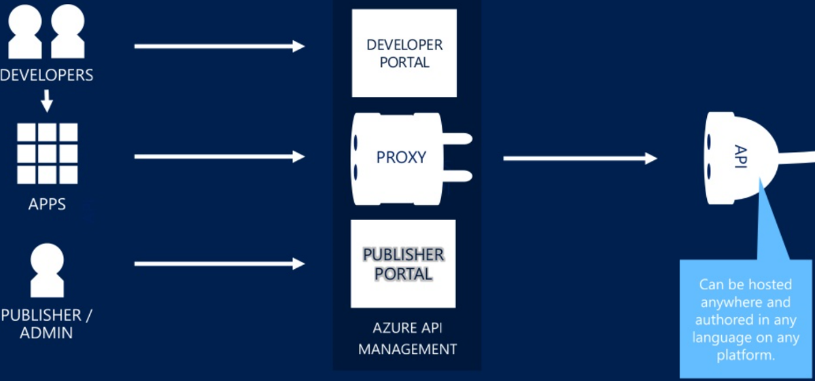
How does it work?

Slide 52
Where it is implemented?
Twilio - API to send text messages or phone calls to the patient night before the appointment.
Fitbit – Calls cloud enabled API to save the health data
Walgreens - Walgreens photo print API allows developer to build compelling app across different platforms and used it to print photos. With every photo print, Walgreens charge few %. Example of public API with direct monetization
GitHub is another example of public API with direct monetization
Amazon APIs gets more hits than Amazon web site throughout the year
DocuSign – Provides electronic signature and digital transaction management API to facilitate electronic exchange of contract and signed documents.
SendGrid – Email infrastructure as a service provider, provides email delivery API
….many more

Slide 53
Azure – Data Storage

Slide 54
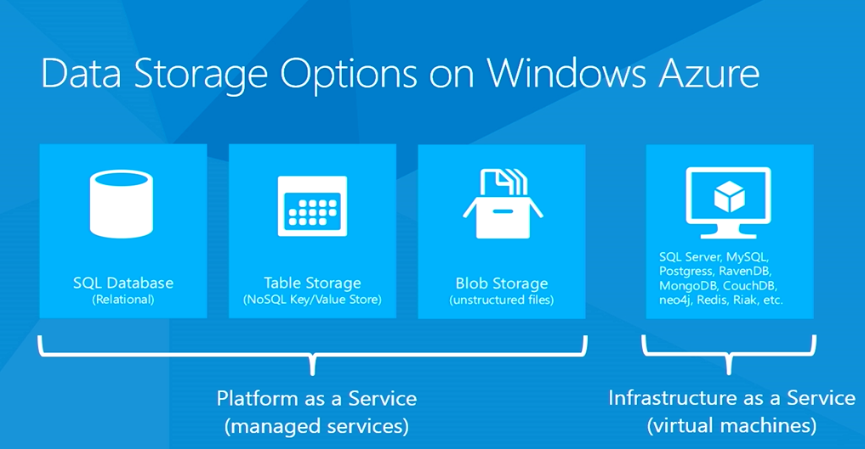

Slide 55
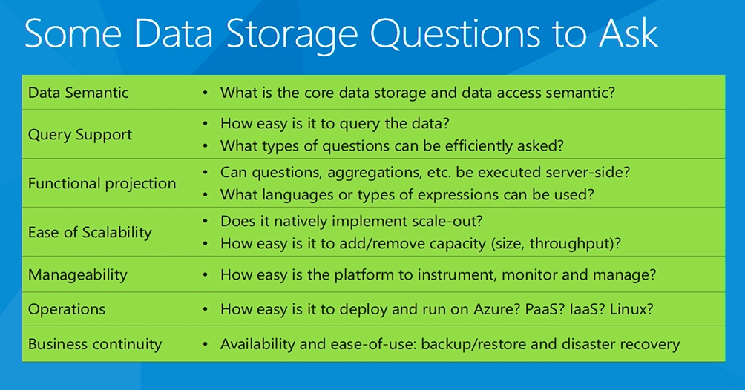

Slide 56
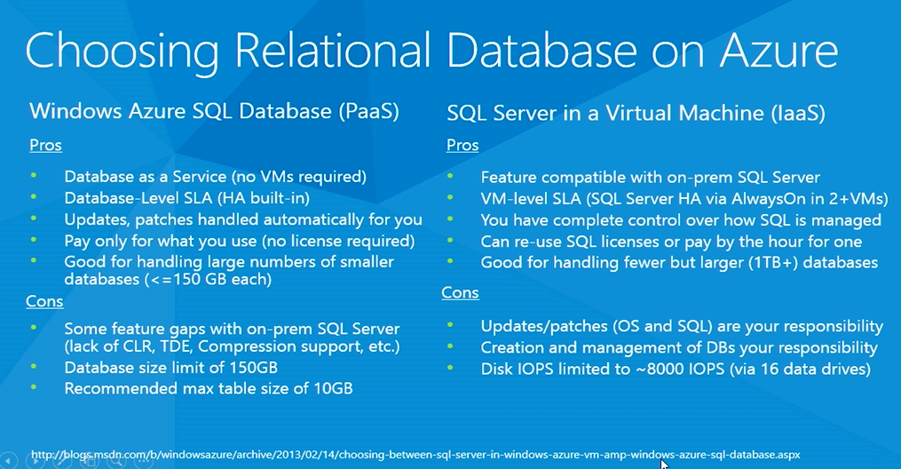

Slide 57
Azure – Machine Learning

Slide 58
Target Audience
Developer
BI Professional
Data Scientist
Enthusiast

Slide 59
Background
What is it?
Why do we need it?
Predictive Analysis

Slide 60
Machine Learning
The goal of a machine learning is to program computers to use example data or past experience to solve given problem

Slide 61
Machine Learning – 2 Parts
Data Grouping – e.g. Amazon ‘You might like this product’
Prediction – Log file parsing for some data pattern matching to figure out the algorithm

Slide 62
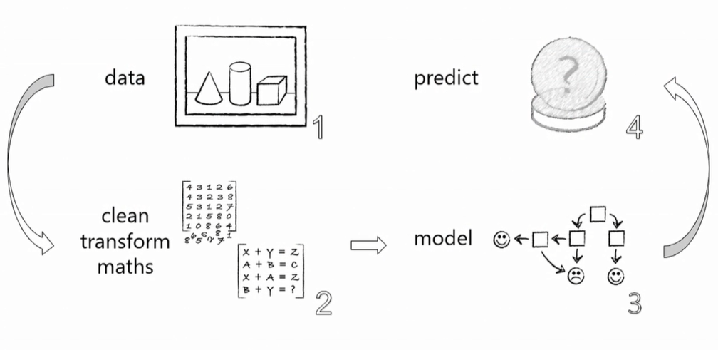
Machine Learning – Typical workflow

